Slide 1
Engineering Design & Innovation 1 Project-PPT for mid semester assessment – January
2023
EDAI1PROJECT_TITLE :- A Novel approach to Detect Clone
app using Sentiment Analysis
Div:- J EDAI_GROUP NO. :- J2 Day :- Saturday Date:- 25-02-2023
❖ Presented by:-
❖ Project Guide:-
Atharva A. Khaire (12210839)
Prasad K. Khambadkar (12210852)
Ayush K. Khambayate (12210365)
Shreyas D. Khamkar (12210220)
Deep M. Khanchandani (12211797)
Om D. Khandare (12210711)
Prof. Dr. Sonali M. Antad
DEPARTMENT OF ENGINEERING SCIENCES AND HUMANITIES (DESH)
VISHWAKARMA INSTITUTE OF TECHNOLOGY,PUNE

Slide 2
EDAI (ENGINEERING DESIGN AND INNOVATION) PRESENTATION GUIDED BY:- Prof. SONALI M. ANTAD.
EDAI PROJECT TITLE :-A Novel approach to Detect Clone app using Sentiment Analysis.

Slide 3

PRESENTED BY :-
GROUP MAMBER | ROLL NO. | PRN NO. | RESPECTIVE WORK DISTRIBUTION
ATHARVA A KHAIRE | 07 | 12210839 | Web Development part and handeling mySQL database
PRASAD K KHAMBADKAR | 08 | 12210852 | The Backend part using machine learning Algorithm
AYUSH K KHAMBAYATE (ASSI. LEADER) | 09 | 12210365 | The Frontend part of project using HTML/CSS
SHREYAS D KHAMKAR | 10 | 12210220 | Representation and layouts of Research Paper
DEEP M KHANCHANDANI | 11 | 12211797 | Identification of proper data sources
OM KHANDARE (LEADER) | 12 | 12210711 | Research paper analysis, . Designing the fraud detection system architecture.

Slide 4
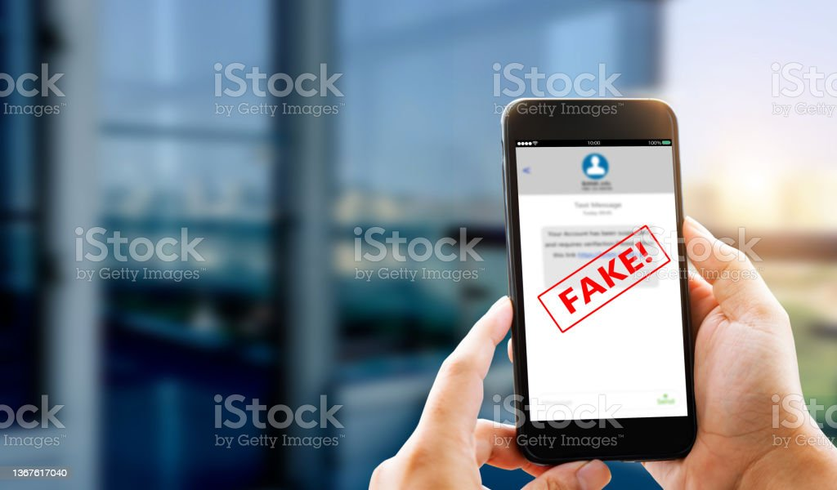
INTRODUCTION TO FRAUD APP DETECTION
Fraud detection includes the entire process of institutions to identify fraudulent activities. These activities can be financial as well as other forms such as fraudulent credit card transactions, data theft, or cyberattacks.

Slide 5
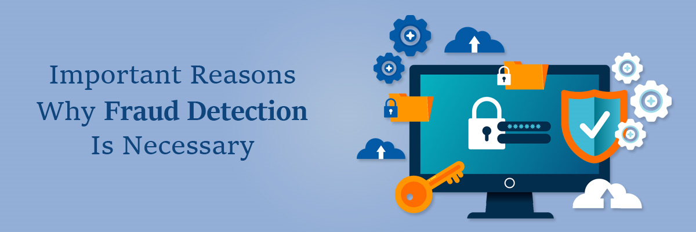
IMPORTANCE OF THE PROJECT :-
Fraud app detection is the process of detecting clone, fake and apps that are involved in fraudulent process.
Fraud app detection is of great importance for several reasons :- Protecting users data, preventing cyberattacks, preventing users from online scams, protecting them from malware.

Slide 6
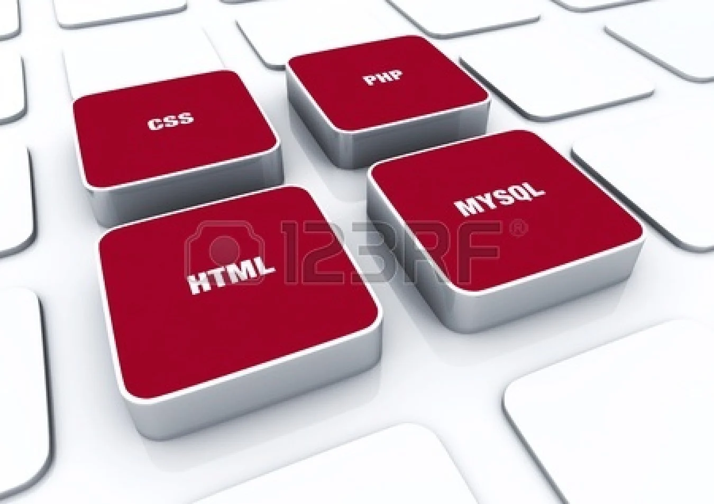
TECHNOLOGY REQUIRED :-
MACHINE LEARNING.
SENTIMENTAL ANALYSIS
SOFTWARES REQUIRED
MY SQL
HTML 5
FLASK
TENSORFLOW

Slide 7
LITERATURE REVIEW :-
Sr No. | TITLE OF THE PAPER | PUBLISHED YEAR | AUTHOR | SUGGESTION | REMARK
1. | FRAUD APP DETECTION | SEPT-2020 | JYOTI SINGH, LAKSHITA SUTHAR | Shows a hybrid shilling attack detector
2. | DETECTION OF FRAUD APP USING SENTIMENT ANALYSIS | MAY-2018 | GAURI RAO | Scalable & can be extended to other domain
3. | DETECTING FRAUD APP USING SENTIMENT | JULY-2019 | MANDAVA RAMA RAO NANDHINI KANNAN | review more practical fraud evidences
4. | RELEVATION OF FRAUD USING SENTIMENT ANALYSIS | 2019 | ASHWINI TICHKULE DEWANAND KAPGATE | Shows a latent relationship among rating,review,ranking
5. | DETECTING FRAUD APP USING SENTIMENT | JULY-2021 | SALINI DHEVADHARSHINI | Experimental research show effectiveness of proposed system

Slide 8
FRAUD DETECTION PROCESS
Extract reviews
Preprocessing
Sentiment analysis
Calculation of Sentiments
Recommendation

Slide 9
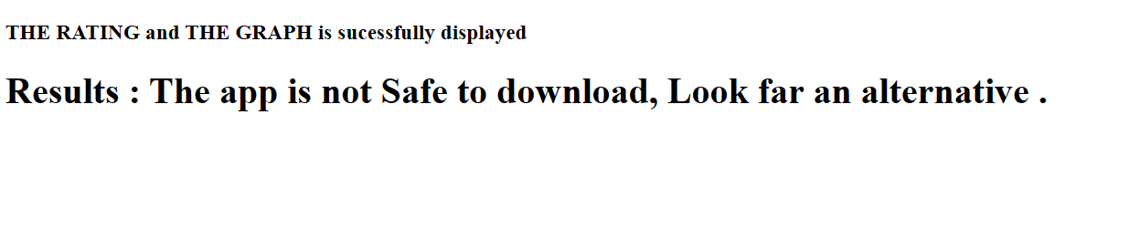
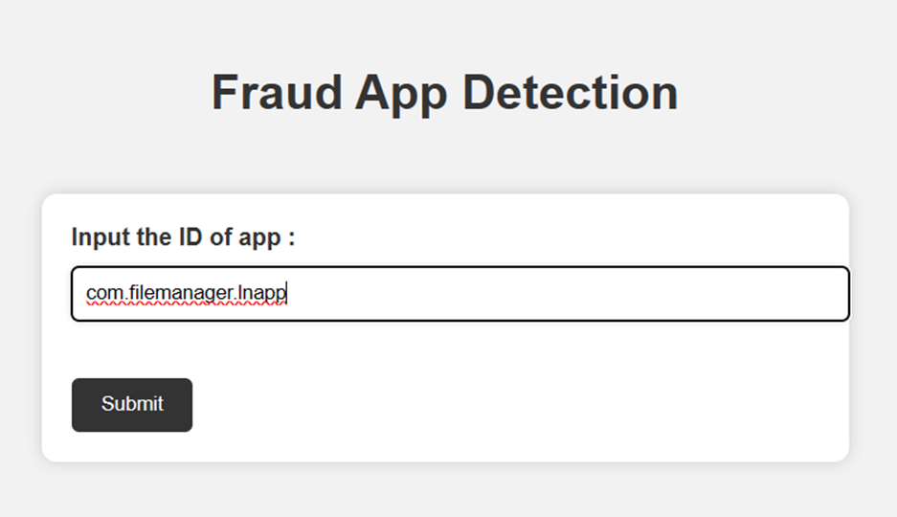
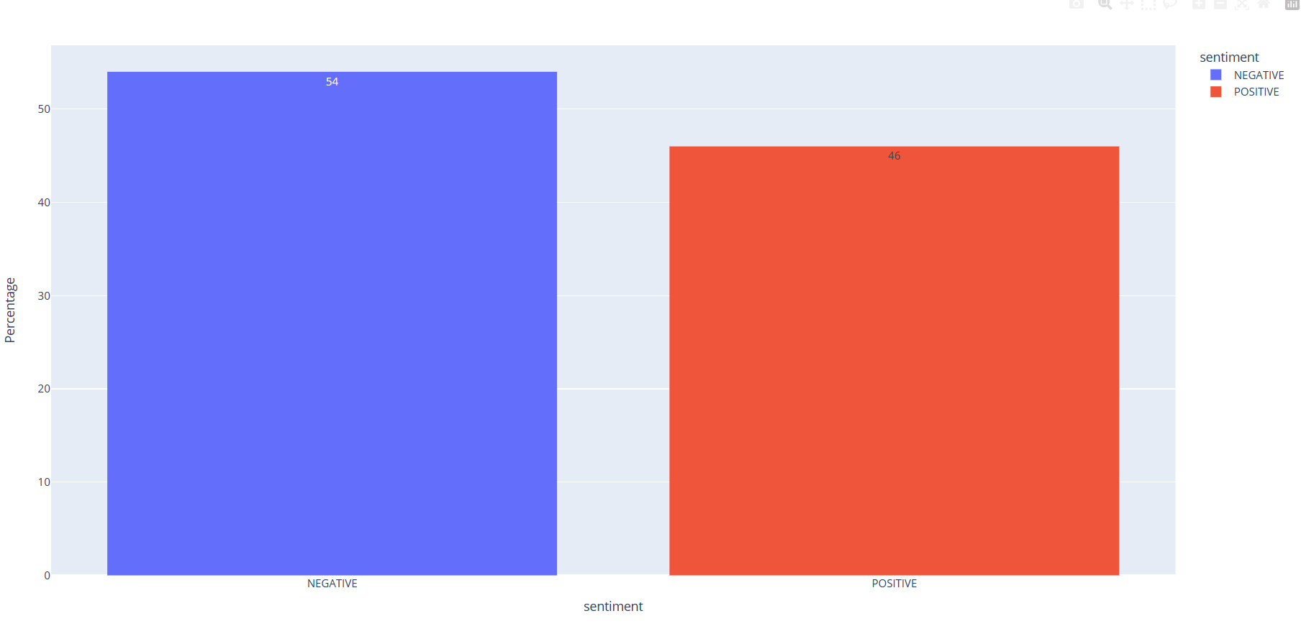
Input and Output
In input we have to input ID of the app and submit
We get recommendation and graph as output

Slide 10
WHAT ARE ADVANTAGE AND DISADVANTAGES REGARDING THE FRAMEWORK :-
ADVANTAGES :-
1. Prevention from Cyber attacks.
2. Prevention from online scams.
3. Enhanced users security.
4. Prevention form leakage of personal information.
5. It's uses high accuracy model for sentiment analysis.
DISADVANTAGES :-
1. Requires active internet connection.
2. System may provide inaccurate results if data entered incorrectly.
3. It requires more time for output if we increase the number of reviews to be taken.

Slide 11
CONCLUSION :-
Overall, the creation of a fraud detection framework can help app stores and marketplaces to mitigate the risks associated with fraudulent mobile apps and provide a safer and more reliable experience for users.
It can also help prevent scams, maintain credibility and secure personal information.
Therefore, the implementation of a fraud detection framework should be considered an essential component of any mobile app store or marketplace.

Slide 12
REFERENCES :-
1. IJARCEE
a. International Journal of Advanced Research in Computer and Communication Engineering ,Salini, Dhevadharashini (Vol. 10,Issue 7, July 2021)(Detecting fraud app using sentiment analysis)
https://nevonprojects.com/detecting-fraud-apps-using-sentiment-analysis/
https://youtu.be/YMMP0VQEvNs
https://ijisrt.com/wp-content/uploads/2018/05/Detection-of-Fraud-Apps-using-Sentiment-Analysis.pdf

Slide 13


